Slide 1

November 09, 2021
CONFIDENTIAL | © 2021 EPAM Systems, Inc.

Slide 2

Agenda
1
About this course
2
Database evolution
3
MS SQL Server overview
4
Data Storage Internals
5
Tables and Indexes
6
Data Modeling

Slide 3
About this course

Slide 4

Vladimir Mitiurin
Lead Software Engineer
20+ years experience in IT
7+ years experience in BI and DB development
Saratov BI Lab head

Slide 5
About the course
External Part
Internal Part
Week 1
Week 5
Week 2
Week 6
Week 3
Week 7
Week 4
Week 8
Technical Interview
Final Task

Slide 6
About the course
MSBI DEVELOPER
MS SQL Server
SSIS
SSAS
Azure
Power BI
OLTP Databases
ETL (Extract – Transform – Load)
Tabular
Storage
Data Modeling
Data Warehouse DWH
Data Base Maintenance
DAX
Azure SQL
Visualizations
T-SQL
Azure Data Factory v2 (ADFv2)
DAX
Administration
Azure DevOps

Slide 7
Database evolution

Slide 8

Database evolution
1
File Management System
2
Hierarchical database System
3
Network Database System
4
Relational Database System (RDBMS)
5
NoSQL, NewSQL

Slide 9

Database evolution
File Management System

Slide 10
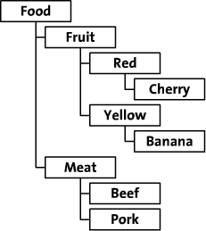
Database evolution
Hierarchical database System

Slide 11
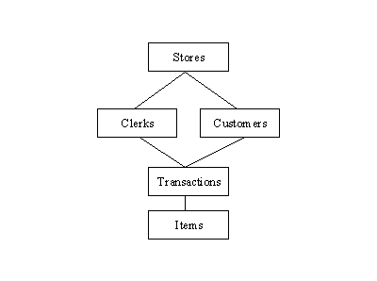
Database evolution
Network Database System

Slide 12
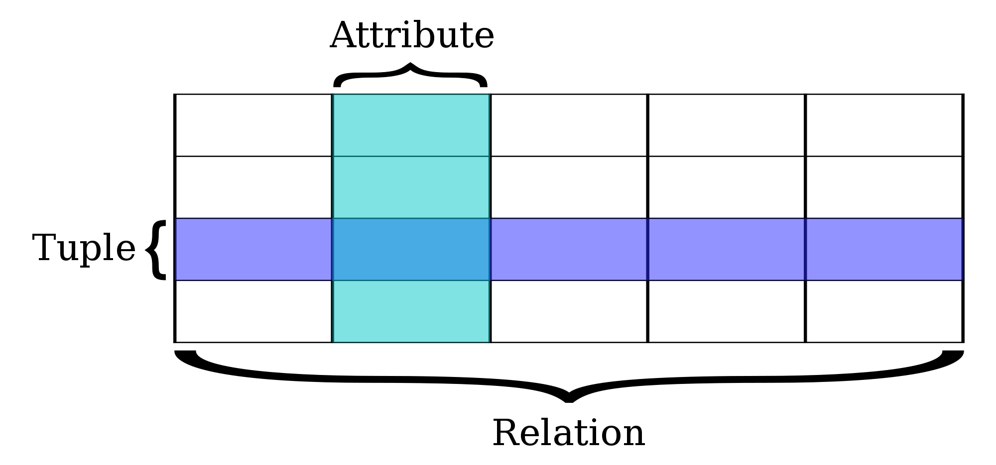
Database evolution
Relational Database System

Slide 13
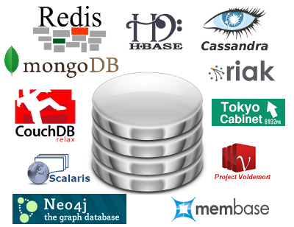
Database evolution
NoSQL

Slide 14
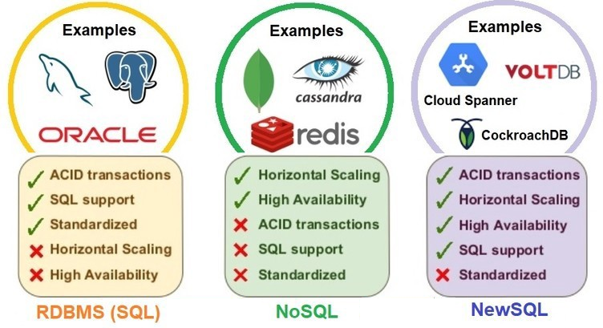
Database evolution
NOSQL, NEWSQL

Slide 15
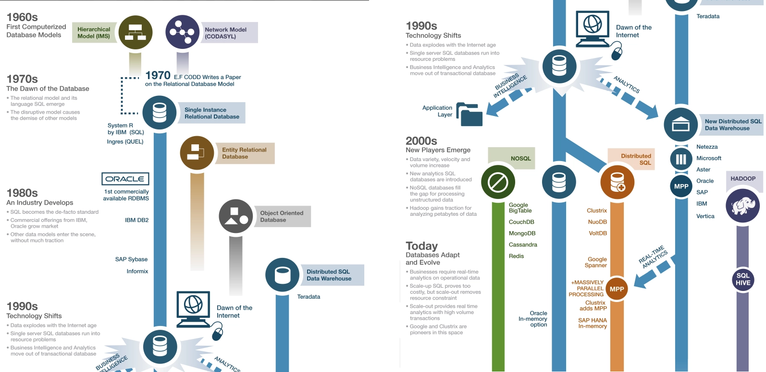
Database evolution

Slide 16
MS SQL Server overview

Slide 17
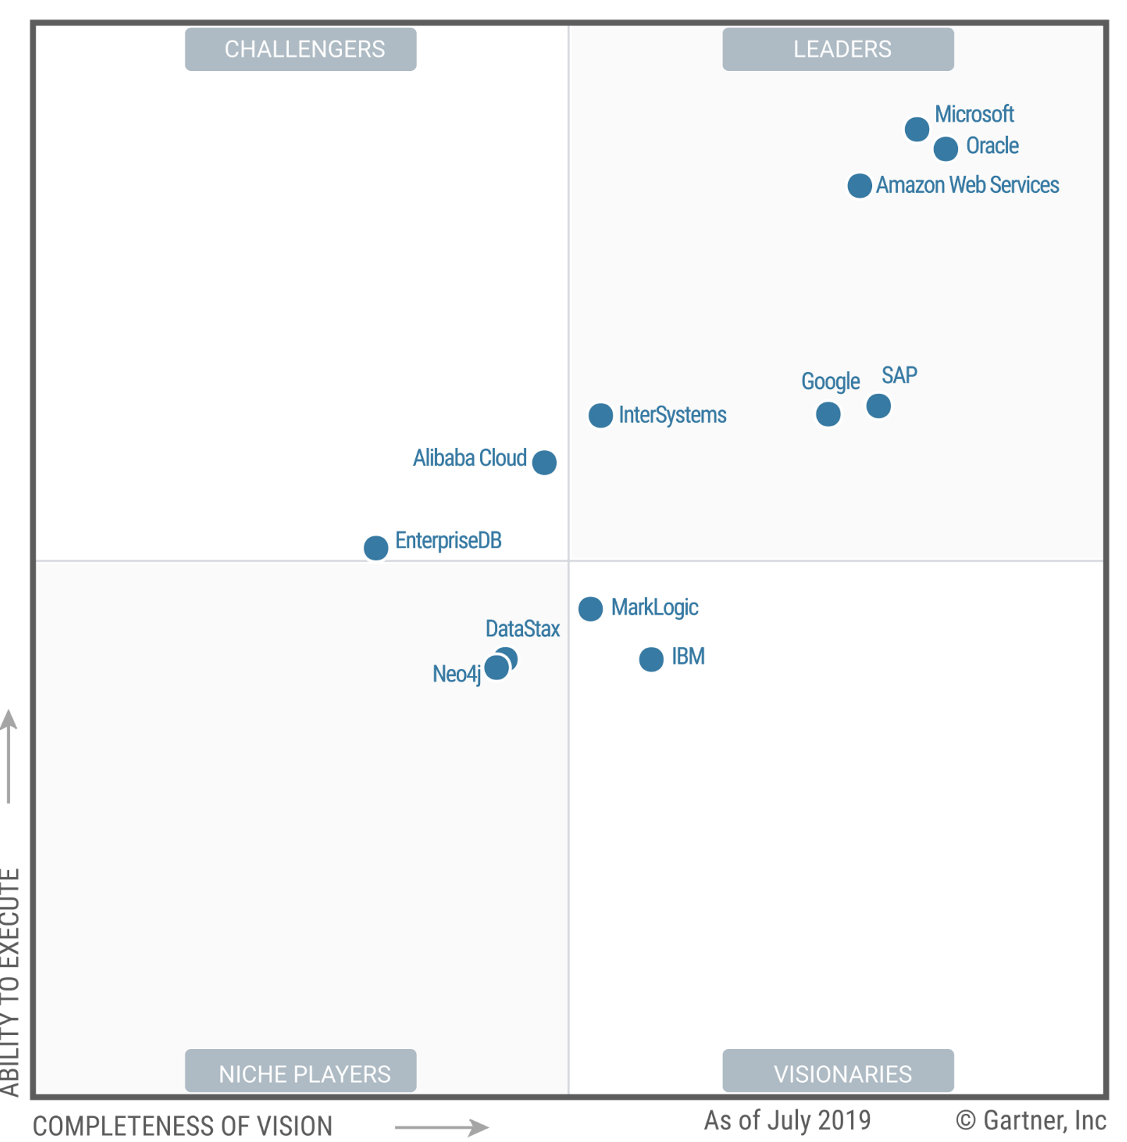
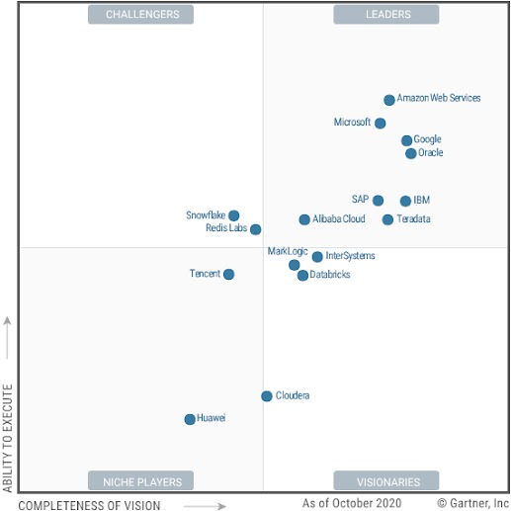
MS SQL Server overview
Magic Quadrant for Cloud Database Management Systems
2019
2020

Slide 18
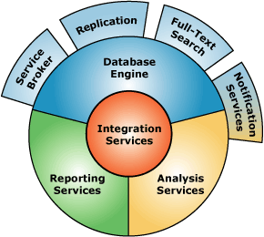
MS SQL Server overview
Key Components
1
Database Engine
2
SQL Server Integration Services (SSIS)
3
SQL Server Analysis Services (SSAS)
4
SQL Server Reporting Services (SSRS)

Slide 19
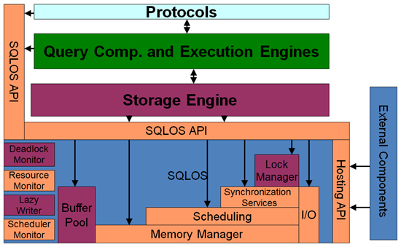
MS SQL Server overview
Database Engine

Slide 20
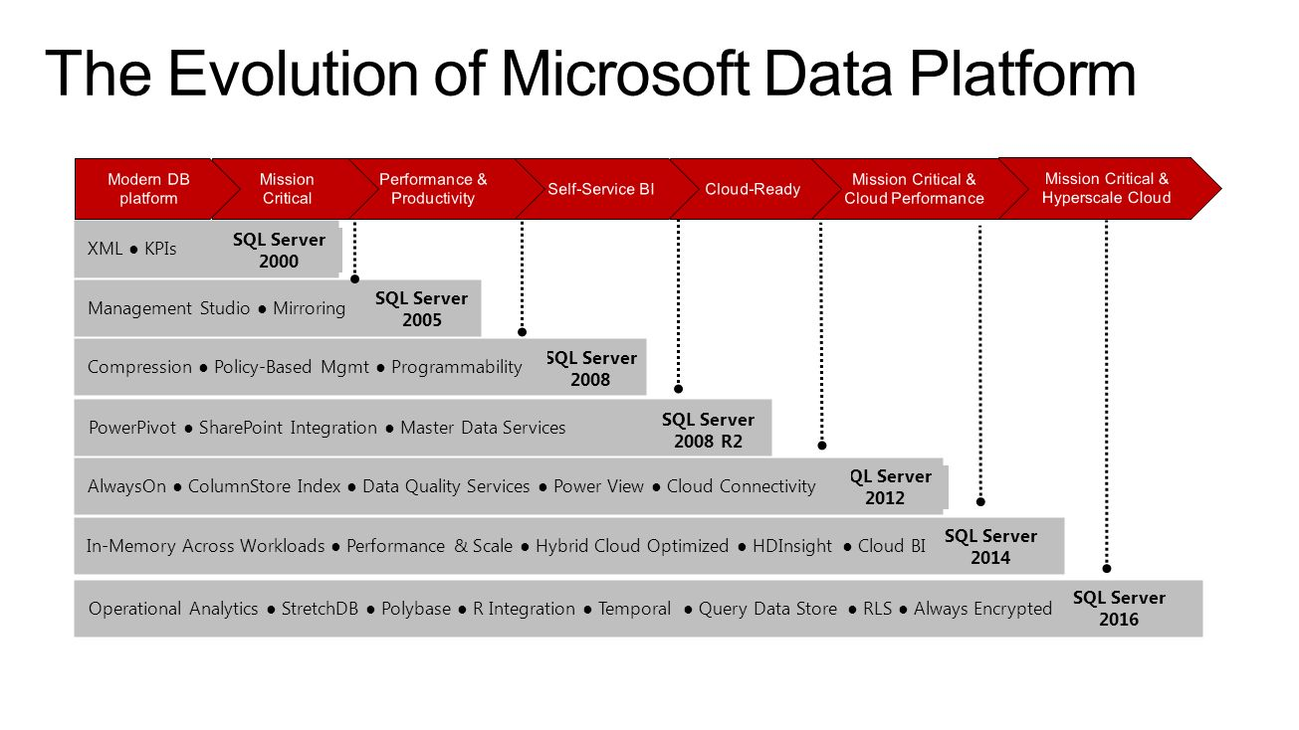
MS SQL Server overview

Slide 21
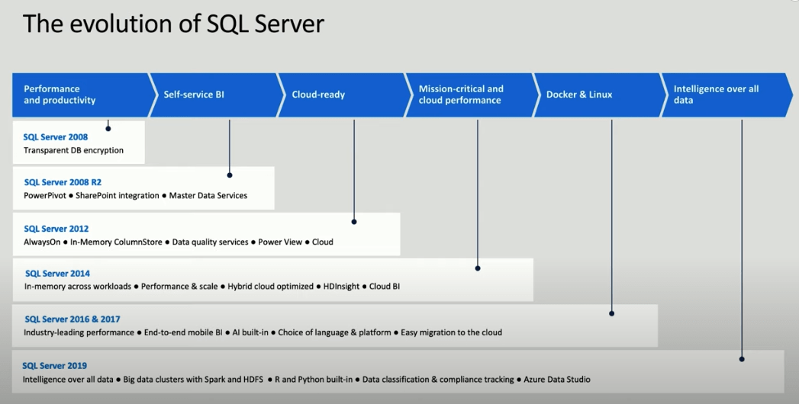
MS SQL Server overview

Slide 22
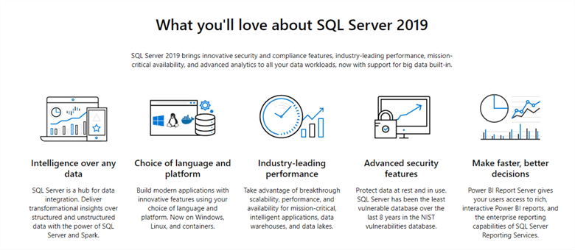
MS SQL Server overview

Slide 23
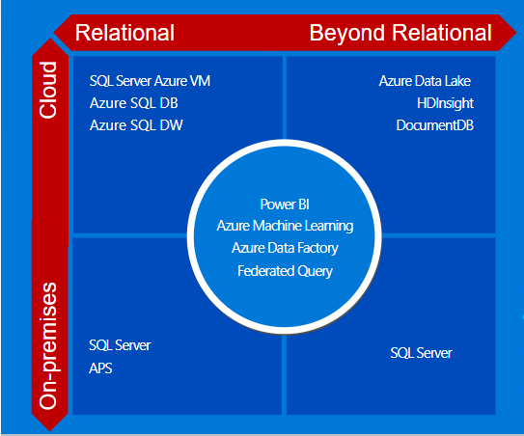
MS SQL Server overview
Trend: Cloud

Slide 24
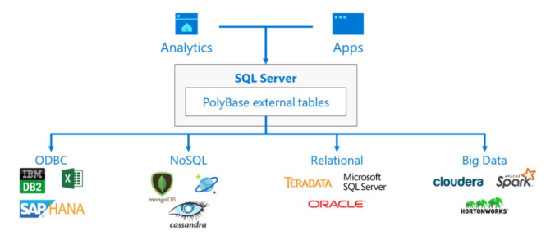
MS SQL Server overview
Trend: Polybase

Slide 25
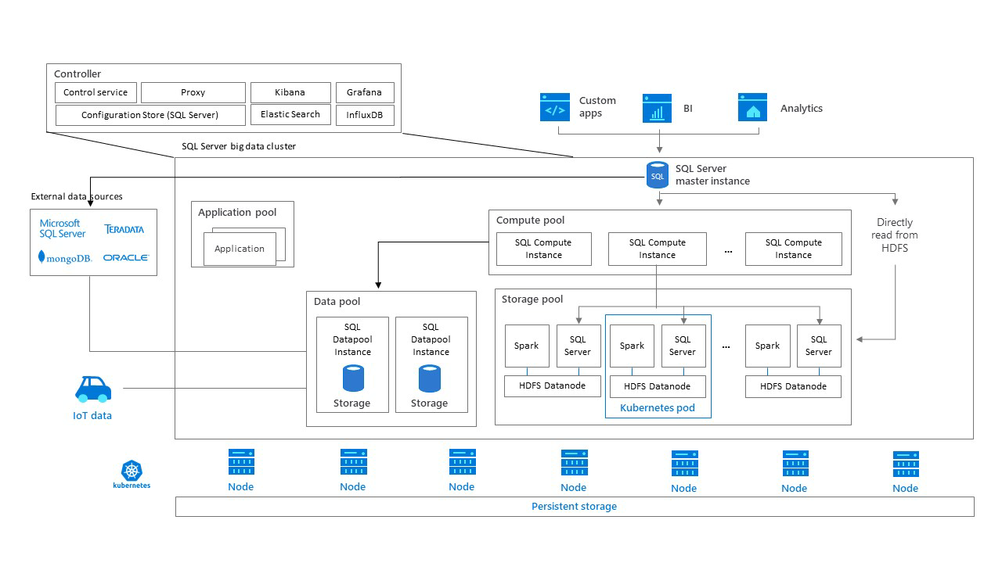
MS SQL Server overview
TREND: Big Data Clusters

Slide 26
Data Storage Internals

Slide 27
Data Storage Internals
Databases
Database Files and Filegroups
Data Pages and Data Rows
Large Objects (LOB) Storage
Extents and Allocation Map Pages
Data Modifications

Slide 28
Data Storage Internals
System Database
master Database
resource Database
msdb Database
model Database
tempdb Database

Slide 29
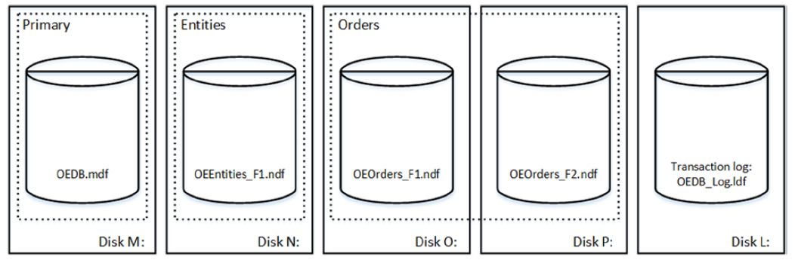
Data Storage Internals
Database Files and Filegroups

Slide 30
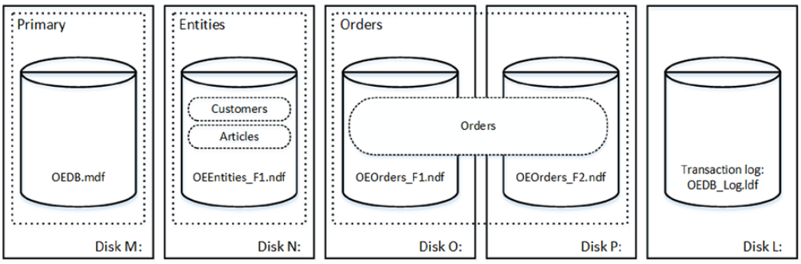
Data Storage Internals
Database Files and Filegroups

Slide 31
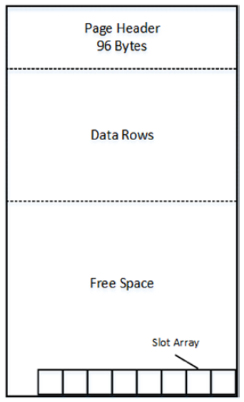
Data Storage Internals
Data Pages and Data Rows
The space in the database is divided into logical 8KB pages

Slide 32
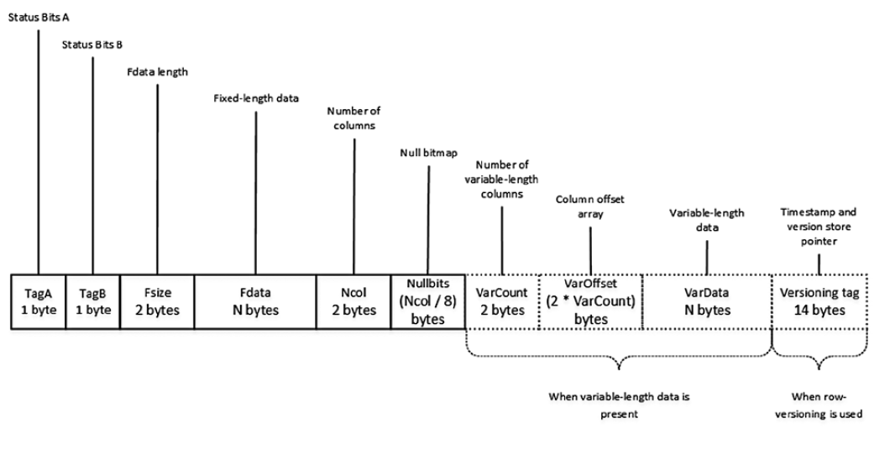
Data Storage Internals
Data Pages and Data Rows

Slide 33
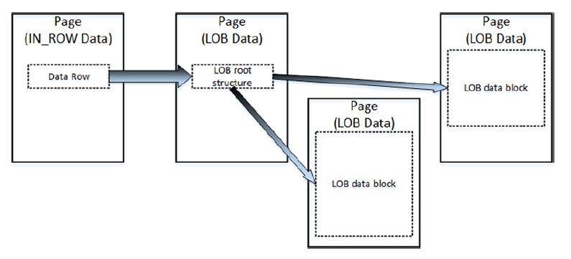
Data Storage Internals
Large Objects Storage
Row-Overflow Storage
LOB Storage

Slide 34
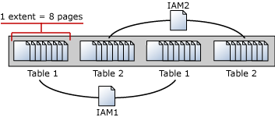
Data Storage Internals
Extents and Allocation Map Pages

Slide 35
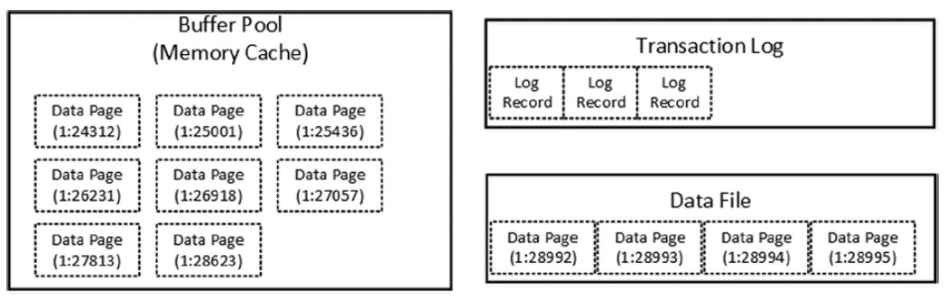
Data Storage Internals
Data Modifications
Initial stage

Slide 36
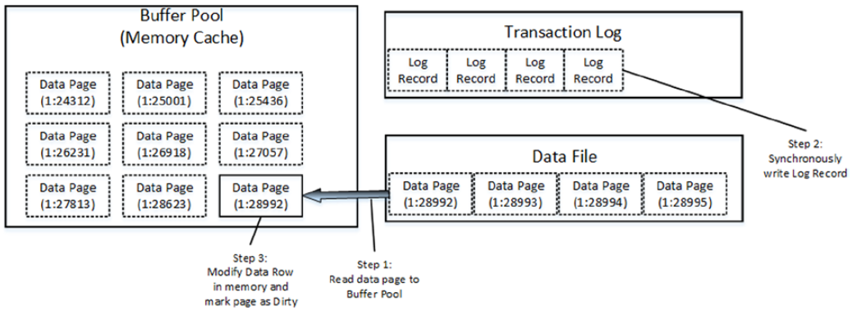
Data Storage Internals
Data Modifications
Modifying data

Slide 37
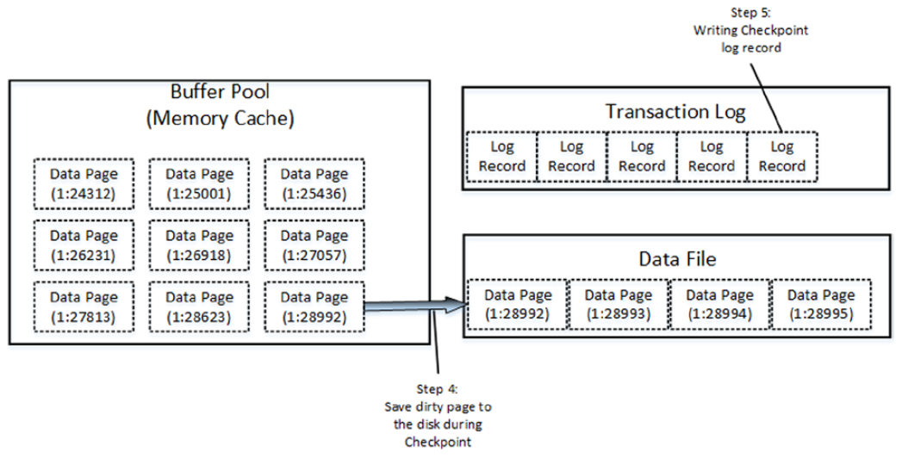
Data Storage Internals
Data Modifications
Checkpoint

Slide 38
Tables and Indexes Internal Structure and Access Methods

Slide 39
Tables and Indexes: Internal Structure and Access Methods
Heap Tables
Clustered Indexes
Composite Indexes
Nonclustered Indexes

Slide 40

Tables and Indexes: Internal Structure and Access Methods
Heap Tables
Heap tables are tables without a clustered index.
The data in heap tables is unsorted.
SQL Server does not guarantee, nor does it maintain, a sorting order of the data in the heap tables.

Slide 41
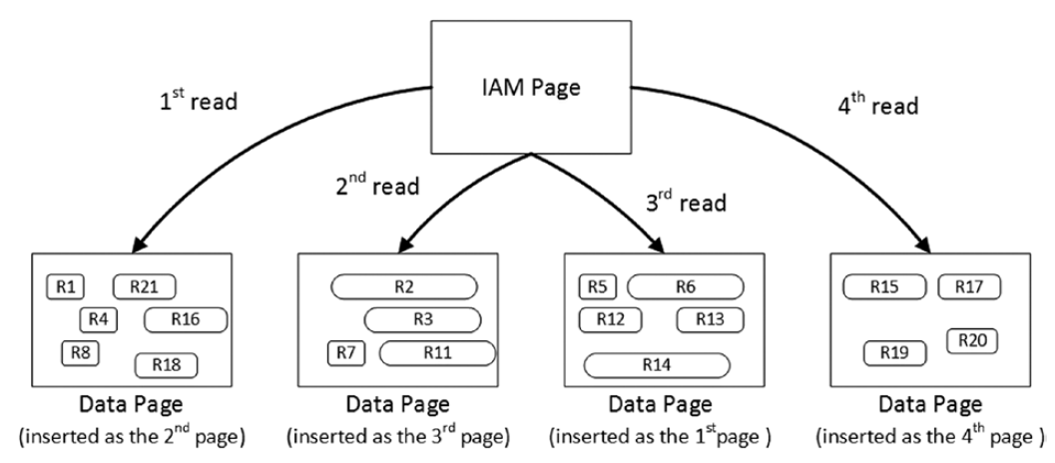
Tables and Indexes: Internal Structure and Access Methods
Heap Tables

Slide 42
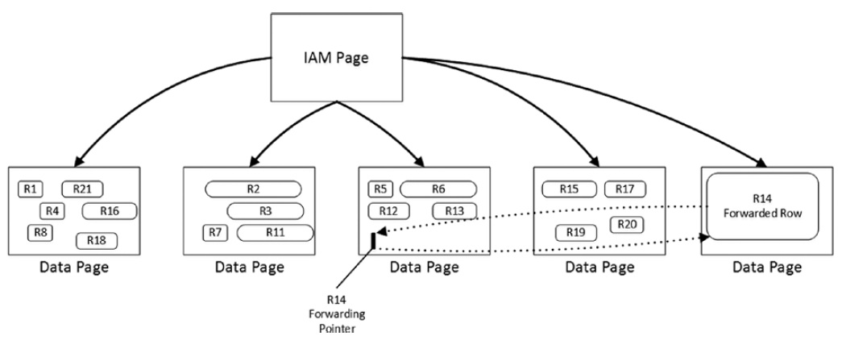
Tables and Indexes: Internal Structure and Access Methods
Heap Tables
Forwarding pointers

Slide 43
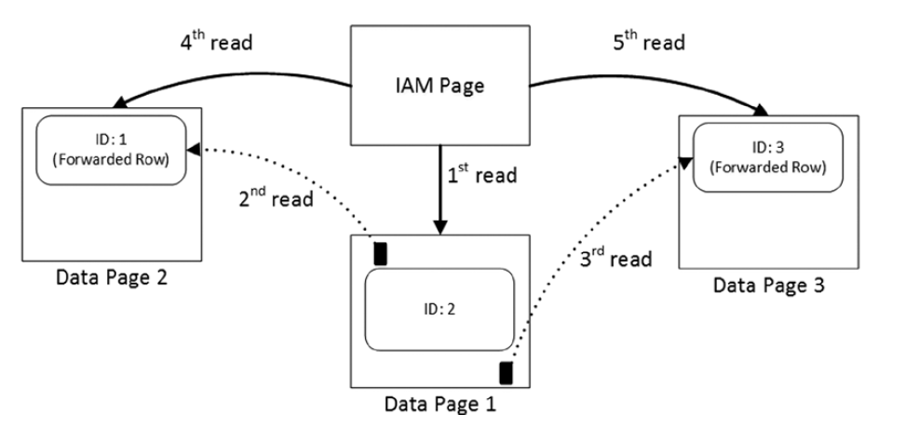
Tables and Indexes: Internal Structure and Access Methods
Heap Tables
Reading data when the forwarding pointers exist

Slide 44

Tables and Indexes: Internal Structure and Access Methods
Clustered Indexes
A clustered index dictates the physical order of the data in a table, which is sorted according to the clustered index key.
The table can have only one clustered index defined.

Slide 45
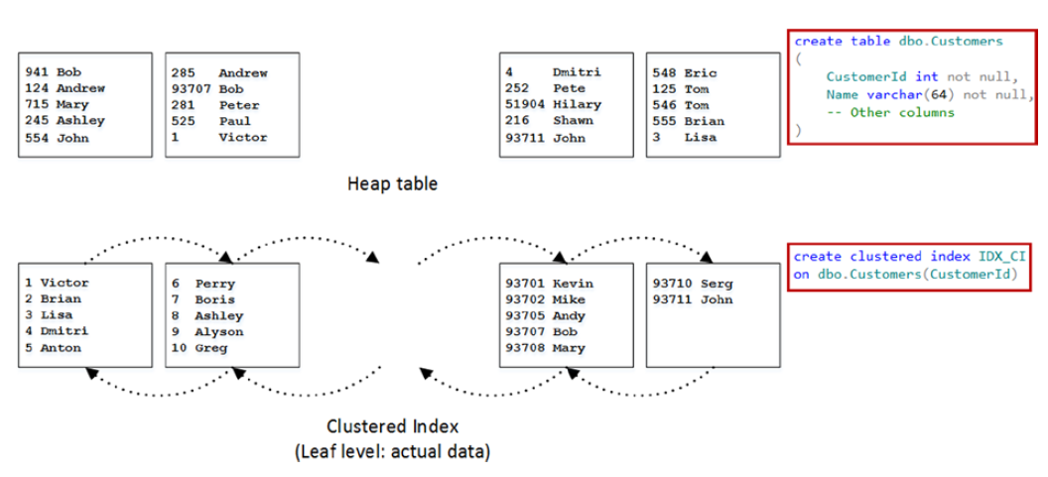
Tables and Indexes: Internal Structure and Access Methods
Clustered Indexes

Slide 46
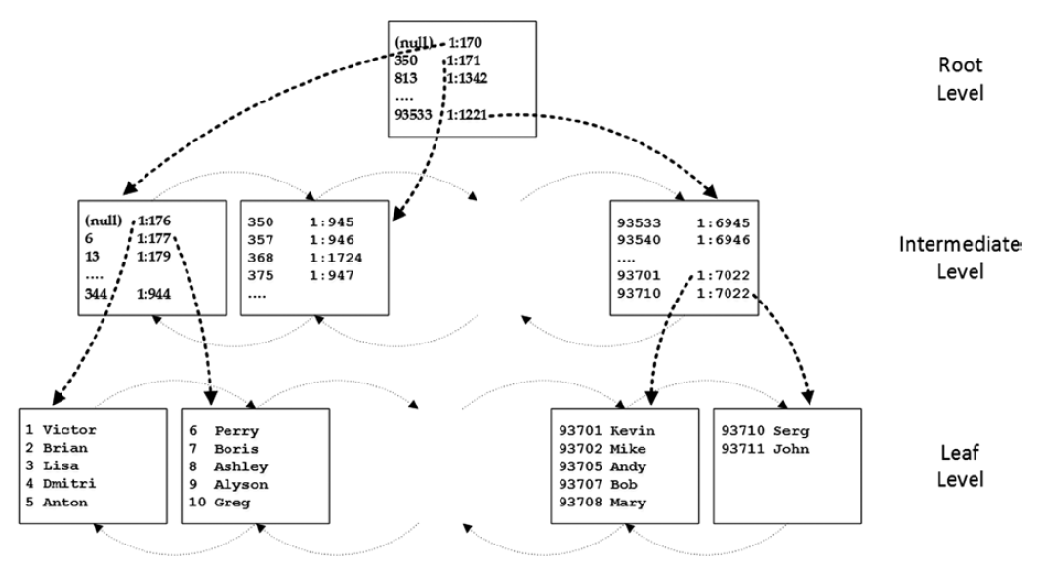
Tables and Indexes: Internal Structure and Access Methods
Clustered Indexes

Slide 47
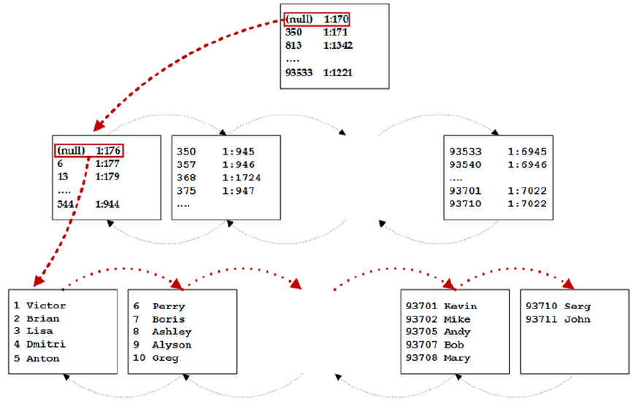
Tables and Indexes: Internal Structure and Access Methods
Clustered Indexes
Ordered index scan

Slide 48
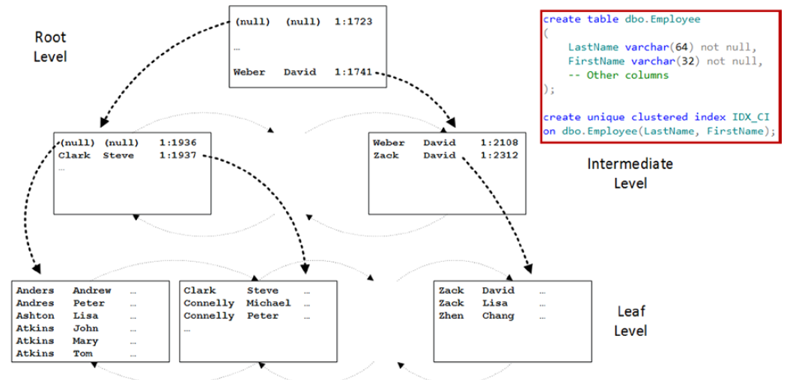
Tables and Indexes: Internal Structure and Access Methods
Composite Indexes

Slide 49
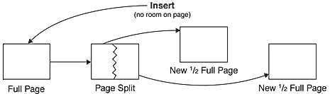
Tables and Indexes: Internal Structure and Access Methods
Page split

Slide 50
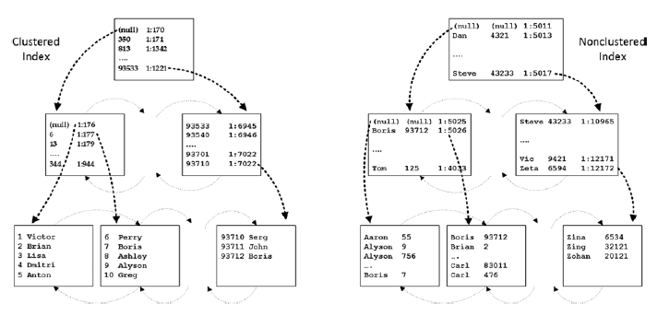
Tables and Indexes: Internal Structure and Access Methods
Nonclustered Indexes

Slide 51
Data Modeling

Slide 52
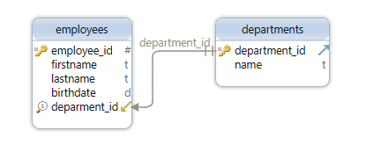
Data Modeling
Keys

Slide 53
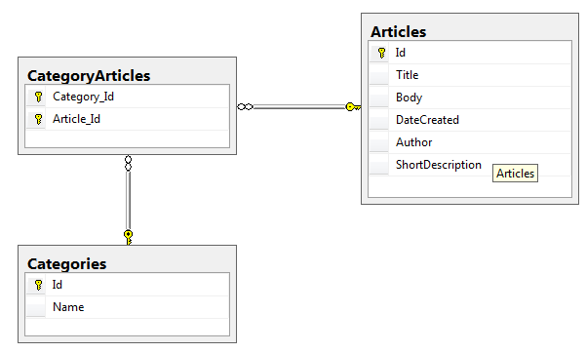
Data Modeling
Many-to-Many Relationship

Slide 54
Data Modeling
Practice Task in 3NF

Slide 55
Data Modeling
Online Shop Use Case Scenario

Slide 56
Data Modeling
Entity-Attribute-Value Pattern (EAV)

Slide 57
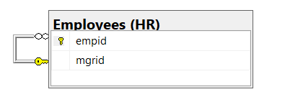
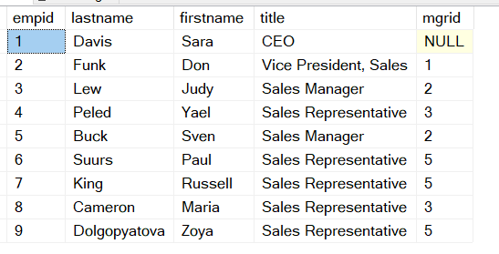
Data Modeling
Hierarchies
Adjacency List Model
Nested Set Model of Hierarchies
Materialized Path (HierarchyID)
https://www.simple-talk.com/sql/performance/the-performance-of-traversing-a-sql-hierarchy-/

Slide 58
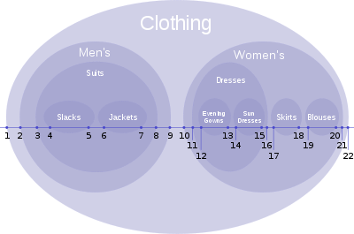
Data Modeling
Hierarchies
Adjacency List Model
Nested Set Model of Hierarchies
Materialized Path (HierarchyID)
Joe Celko’s Trees and Hierarchies in SQL for Smarties

Slide 59
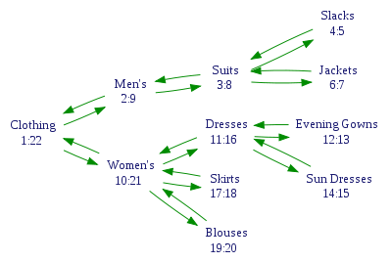
Data Modeling
Hierarchies
Adjacency List Model
Nested Set Model of Hierarchies
Materialized Path (HierarchyID)
Joe Celko’s Trees and Hierarchies in SQL for Smarties

Slide 60
Data Modeling
Hierarchies
Adjacency List Model
Nested Set Model of Hierarchies
Materialized Path (HierarchyID)
https://docs.microsoft.com/en-us/sql/t-sql/data-types/hierarchyid-data-type-method-reference

Slide 61
Q&A Session

